Slide 1
AMERICAN WEST IN ENGLISH WORDS

Slide 2
Konkurs polega na wybraniu poprawnej odpowiedzi.
Wypełnione karty odpowiedzi prosimy wysyłać na adres: aneta.antokolska@put.poznan.pl
Data zakończenia konkursu: 27.01.2023r.
Wśród autorów poprawnych odpowiedzi zostaną rozlosowane atrakcyjne nagrody.
KONKURS PRZEZNACZONY JEST DLA STUDENTÓW PP ŻYCZYMY POWODZENIA !

Slide 3
Choose the correct answer.
Send the answer sheet to: aneta.antokolska@put.poznan.pl
The deadline is: January 27, 2023.
The contest winner will receive an attractive prize.
THE QUIZ IS AIMED AT PUT STUDENTS
GOOD LUCK!

Slide 4
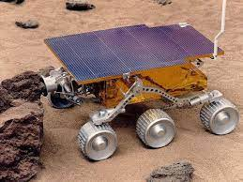
1. A pathfinder means:
a person or an object that finds a new way of doing something
a route or track between one place and another
a place where three or more roads join and traffic must go around a circular area in the middle

Slide 5
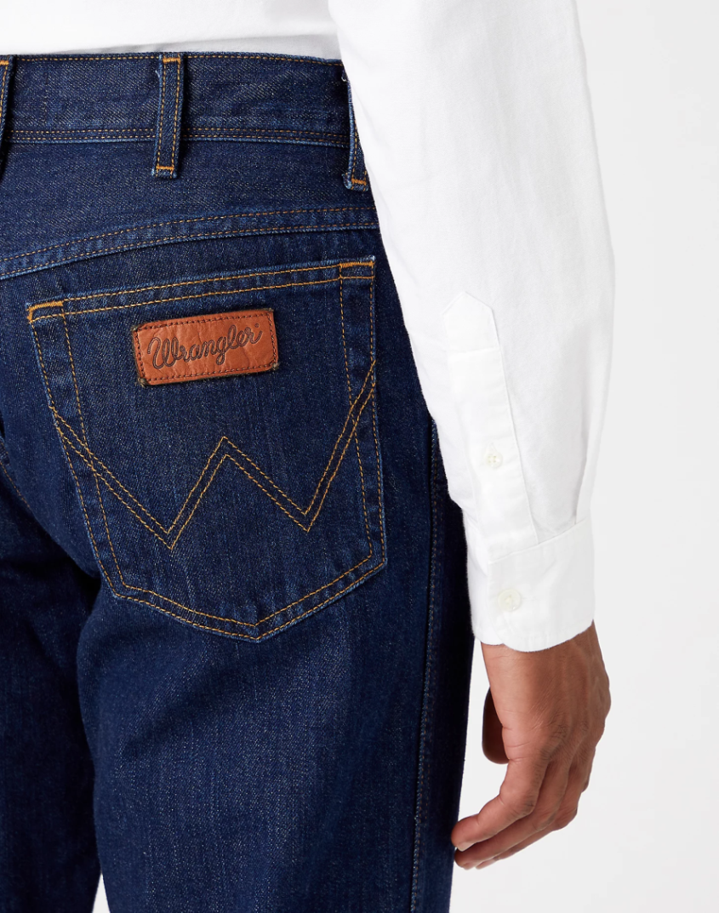
2. A wrangler is:
a person whose job is to protect a forest or natural park
a person who spends their time travelling from place to place
someone who looks after horses or other animals on a ranch

Slide 6
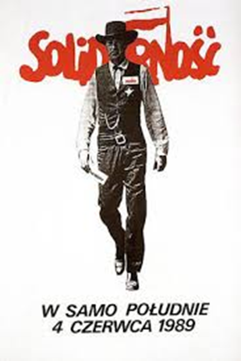
3. High Noon is a Western movie. The plot centers on a town marshal whose sense of duty is tested when he must decide to either face a gang of killers alone, or leave town with his new wife. The film stars:
John Wayne
Clint Eastwood
Gary Cooper

Slide 7
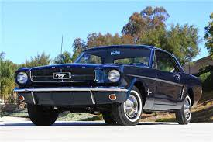
4. The legend has it that the original Ford Mustang of 1964 was named after:
a man who performs stunts, especially instead of an actor in a film or television program
an American wild horse roaming the plains
a horse breed originally from the Arabian Peninsula, with a high tail and a particular shape of head

Slide 8
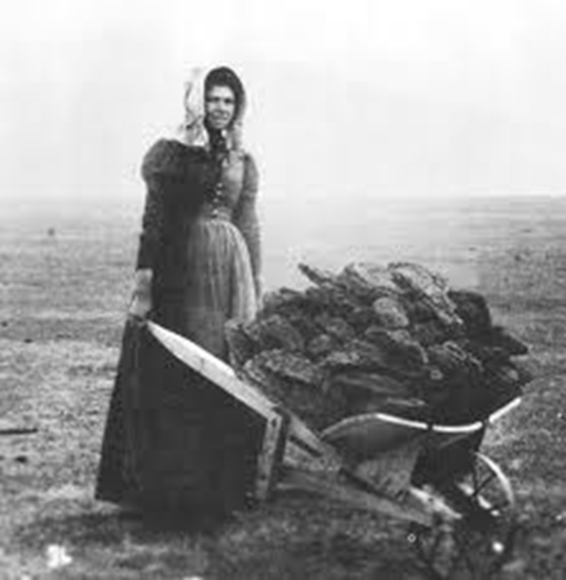
5. Buffalo chips, the dried dung of buffalo, were used as fuel, esp. by early settlers on the western plains. The were also called:
meadow crisps
western coal
meadow muffins

Slide 9
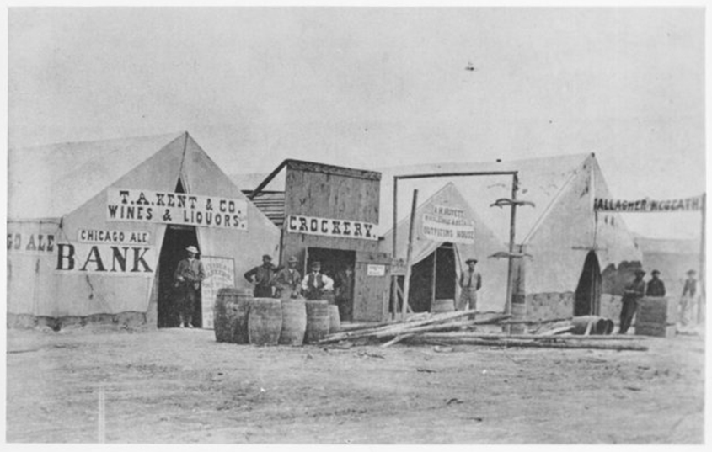
6. This expression originated with the building of the Union Pacific Railroad in the 1860s, when it meant the last town on the line, which was carried on freight cars as the track was extended. The town consisted mainly of tents occupied by construction gangs, liquor dealers and gamblers. The phrase is:
hell on wheels
red light district
saloon

Slide 10
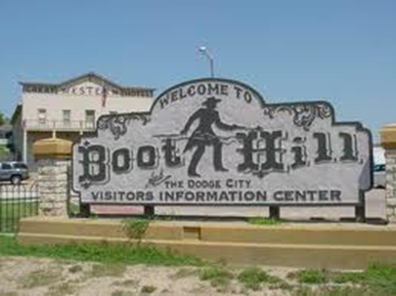
7. Although many western towns used the name Boot Hill, the first graveyard named Boot Hill was at Hays, Kansas. The term refers to the fact that many of its occupants were cowboys who died violently, as in gunfights or by hanging, and not of natural causes. In other words, they died:
with their boots off
with their boots on
bootcut

Slide 11
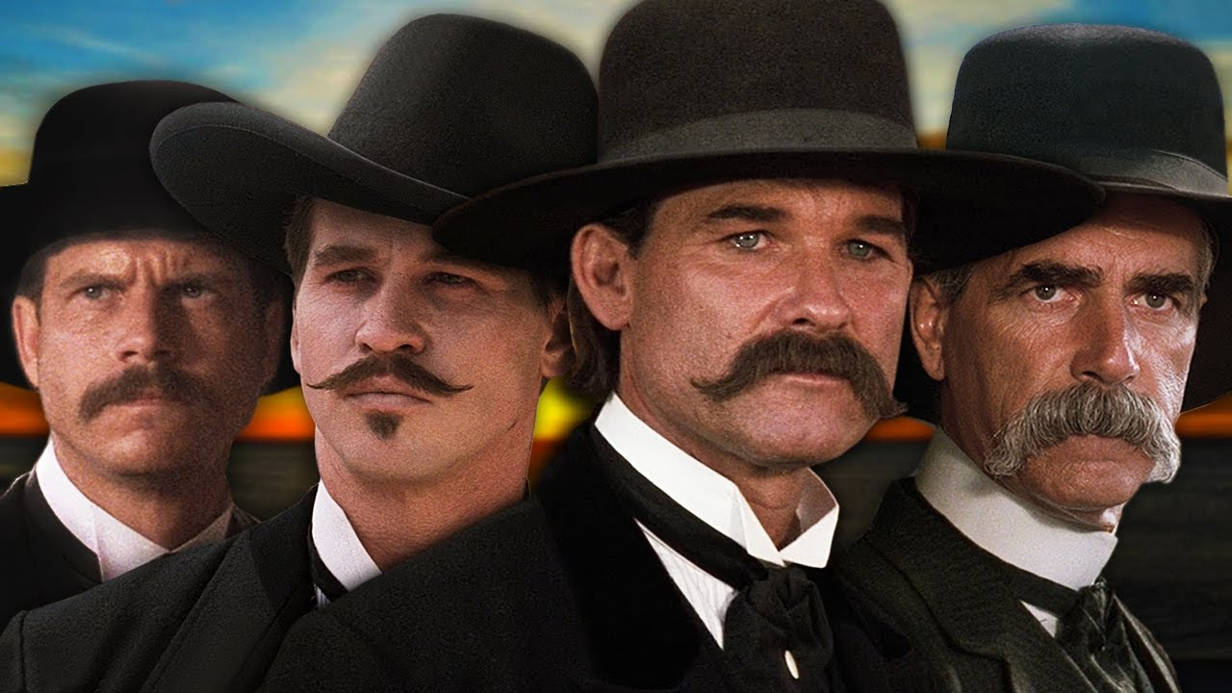
8. Tombstone, Arizona, was known to „have a man for breakfast every morning”. The film Tombstone is based on real events that took place in the 1880s in the town, including the most famous gunfight, which took place at:
O.K. Corral
Brunch Saloon
Main Street

Slide 12
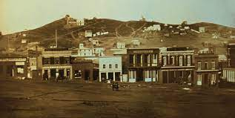
9. The name of this town was taken from the yerba buena plant, a native herb of the West Coast of North America. Yerba Buena was the original name of the settlement that later became:
Los Angeles
San Francisco
Sacramento

Slide 13
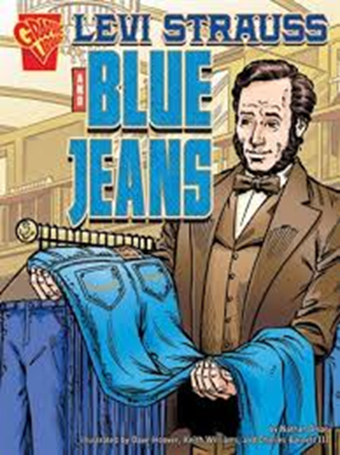
10. These most popular clothes on earth, Levi’s® blue jeans, were made out of denim and reinforced with metal rivets. They became exceptionally popular with:
gold miners in California
American trappers
Native Americans

