Slide 1
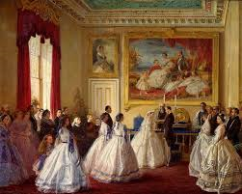
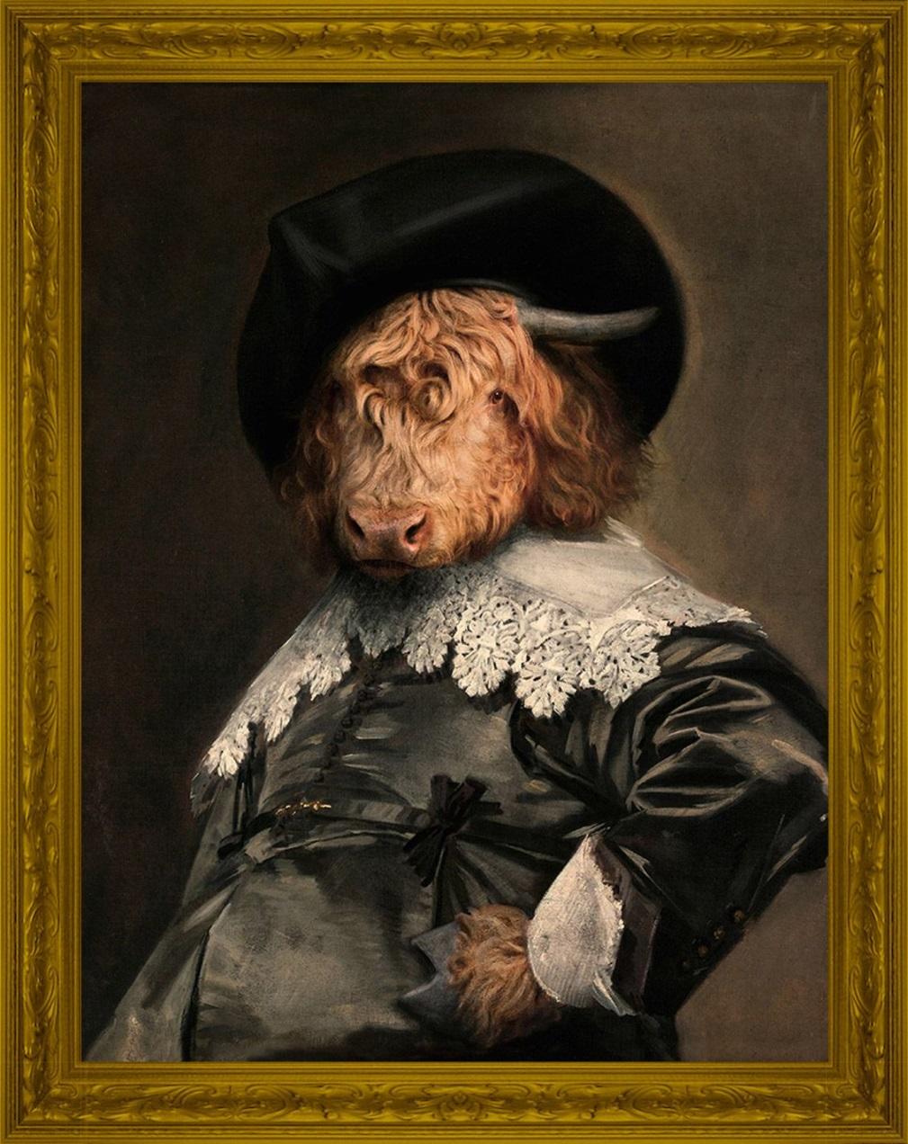
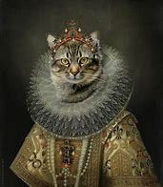
Aristocracy and pop culture

Slide 2
Konkurs polega na wybraniu poprawnej odpowiedzi na każde z 11 stwierdzeń: T/F
Wypełnione karty odpowiedzi prosimy wysyłać na adres: barbara.budner@put.poznan.pl
Data zakończenia konkursu: 23.04.2023r.
Wśród autorów poprawnych odpowiedzi zostanie rozlosowana nagroda.
KONKURS PRZEZNACZONY JEST DLA STUDENTÓW PP
ŻYCZYMY POWODZENIA !

Slide 3
The quiz is about choosing the correct answer to each of the 11 statements: T/F
Send the completed answer cards to: barbara.budner@put.poznan.pl
The deadline is: 23.04.2023.
Among the correct answers a prize will be drawn.
THE QUIZ IS ONLY FOR PUT STUDENTS
GOOD LUCK!

Slide 4
TRUE OR FALSE?
Lord Sommersby
is famous for throwing incredible parties.
1. He exists/existed as a real person.

Slide 5
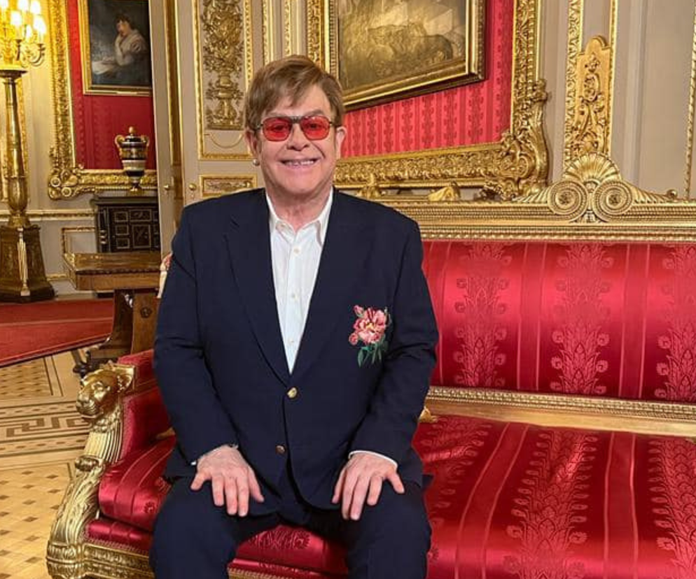
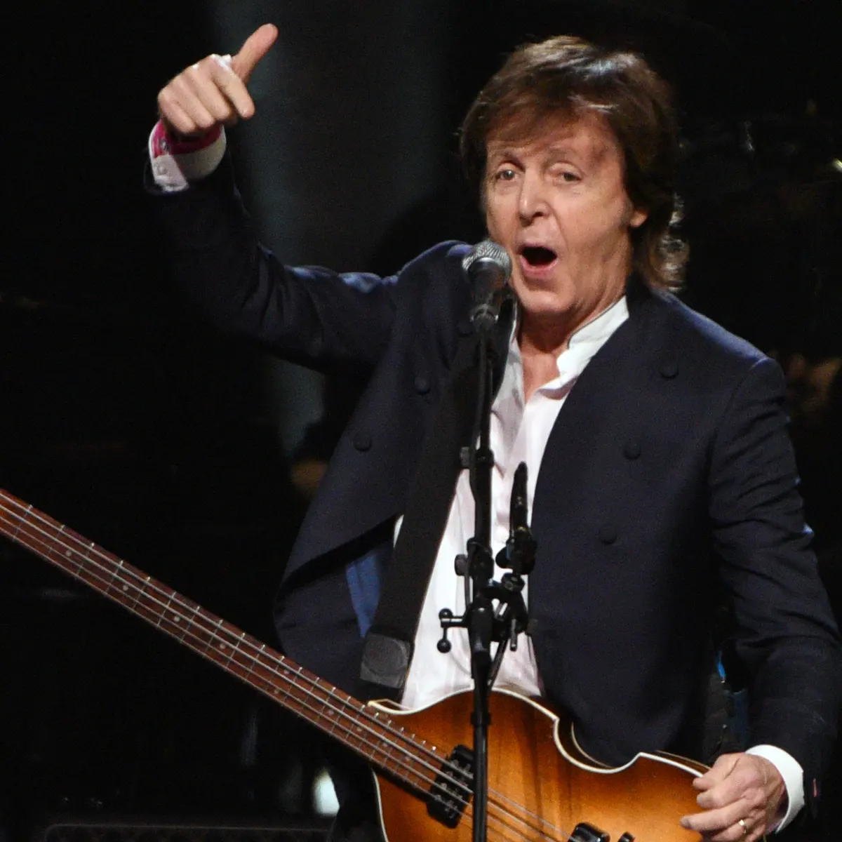
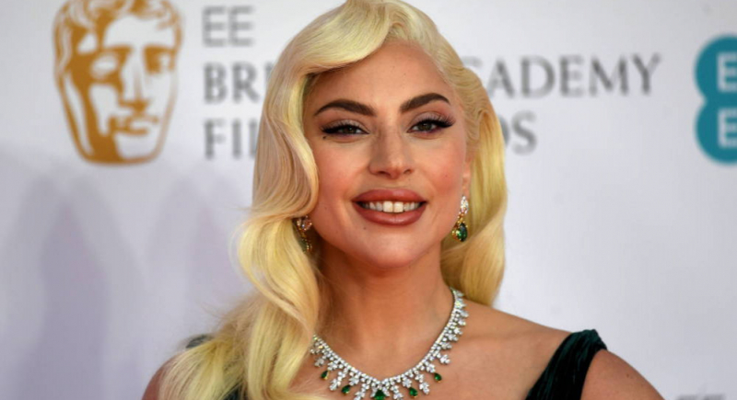
TRUE OR FALSE?
Sir Elton John was knighted
(can use the official title ’Sir’)
by Queen Elizabeth II
for his services to music (in 1998)
2. So was Sir Paul McCartney (member of the Beatles)
3. So was Lady Gaga

Slide 6
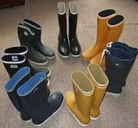
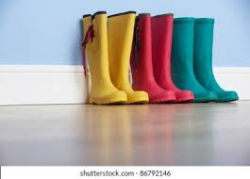
TRUE OR FALSE?
WELLINGTONS
the rubber boots
4. were named after Arthur Wellesley, 1st Duke of Wellington (one of the commanders who won at the Battle of Waterloo in 1815).

Slide 7
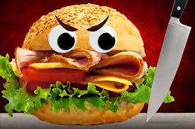
TRUE OR FALSE?
SANDWICH
5. was named after the
4th Earl of Sandwich
who ate slices of cold beef between two slices of bread while gambling

Slide 8
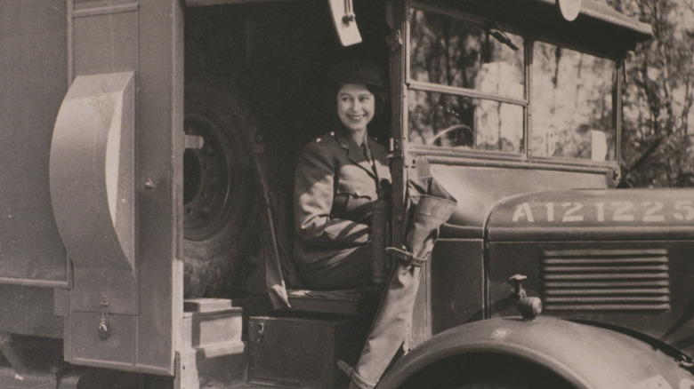
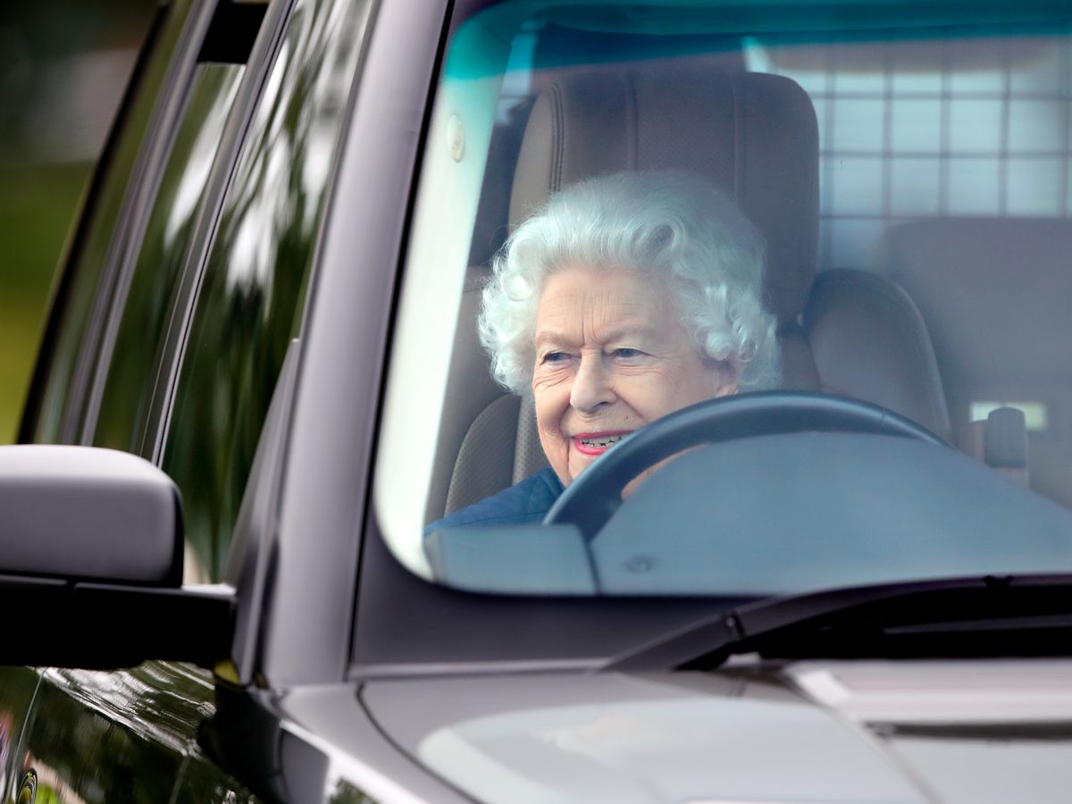
TRUE OR FALSE?
Queen Elizabeth II
6. Had an account on Instagram
7. Did not have
a driving licence, but was allowed to and did drive cars

Slide 9
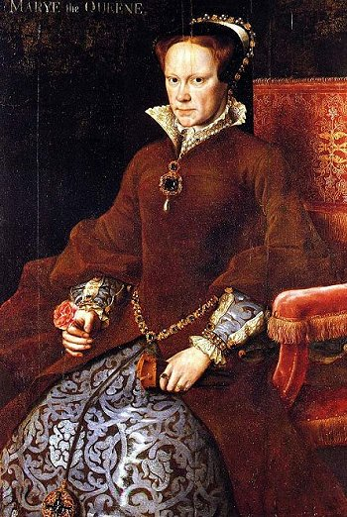
TRUE OR FALSE?
Bloody Mary
8. was the nickname of Queen Mary I of England
9. was the Queen’s favourite tomato cocktail drink

Slide 10
TRUE OR FALSE?
McDonald’s
10. was established by Sir Ronald McDonald
the rich member of one of
the oldest Scottish clans
called Lords of the Isles

Slide 11
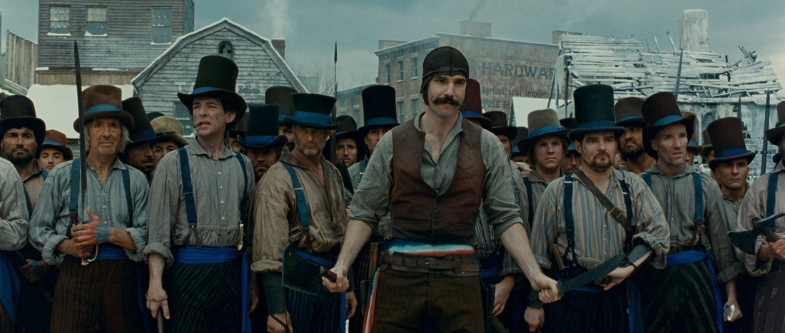
TRUE OR FALSE?
11. First use of the word appeared in London police-court reports in 1894, referring to the king of a gang of youths in London
‘hooligan’

