Slide 1
SILICON VALLEY
IN ENGLISH PHRASES

Slide 2
Konkurs polega na wybraniu poprawnej odpowiedzi.
Wypełnione karty odpowiedzi prosimy wysyłać na adres:
aneta.antokolska@put.poznan.pl
Data zakończenia konkursu: 11.06.2023r.
Wśród autorów poprawnych odpowiedzi zostaną rozlosowane atrakcyjne nagrody.
KONKURS PRZEZNACZONY JEST DLA STUDENTÓW PP
ŻYCZYMY POWODZENIA !

Slide 3
Choose the correct answer.
Send the answer sheet to: aneta.antokolska@put.poznan.pl
The deadline is: June 11, 2023.
The contest winner will receive an attractive prize.
THE QUIZ IS AIMED AT PUT STUDENTS
GOOD LUCK!

Slide 4
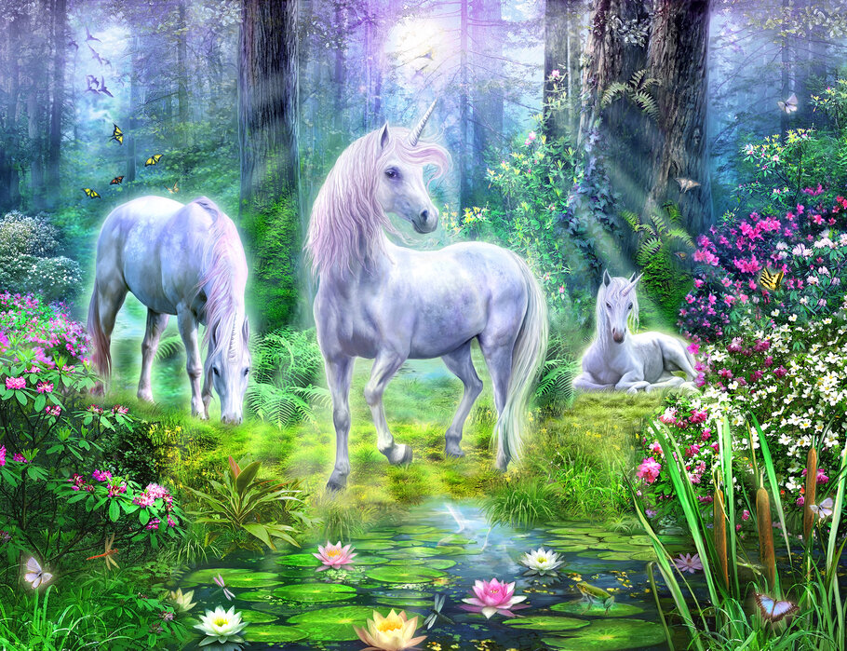
1
UNICORN is:
a) a startup that’s worth more than ten billion dollars
b) a startup that’s worth more than one billion dollars
c) a startup that is very vulnerable in the business world

Slide 5
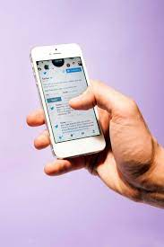
2
PROCRASTATWEETING means:
using Twitter instead of doing whatever you're supposed to be doing
a person's ability to do more than one thing at a time while using Twitter
publishing a short remark or piece of information on Twitter

Slide 6
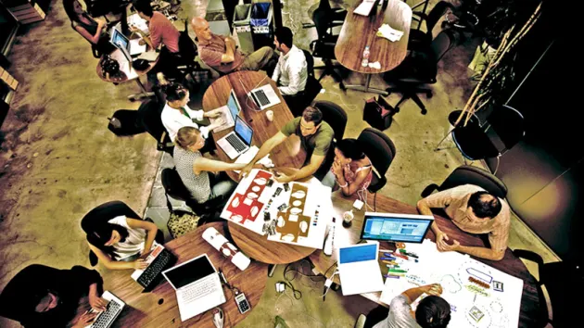
3
INCULATOR is:
a) a combination of a startup incubator and accelerator, supporting a business for about a year
b) a material or covering that electricity, heat, or sound cannot go through
c) a substance that allows heat or electricity to go through it

Slide 7
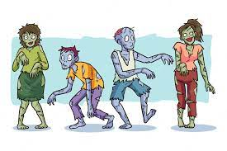
4
You are in a ZOMBIE MODE when:
a) you move around as if unconscious and being controlled by a politician who wants you to commit a crime
b) you talk to someone, but instead of paying attention and maintaining eye contact, your attention is on your phone and you hardly take your eyes away from it
c) you commute to work or school in the morning, actively engaging your phone throughout the journey and looking up only once in a while to see if you have gotten to your destination

Slide 8
5
MICROSERF is:
a) an extremely small robot working for the IT sector
b) an individual working in a low-paid position using information technologies, usually with only basic qualifications, unable to move to a better position
c) a natural language processing tool driven by AI technology that allows you to have human-like conversations with the chat bot

Slide 9
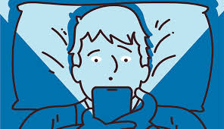
6
PHONE SLEEP is:
a) when you accidentally fall asleep with your head on your phone
b) the period of time you spend checking your phone,
on bed, before you finally fall asleep
c) a low power mode for electronic devices such as phones

Slide 10
7
GIFIFY means:
a) to convert any video file to an optimized animated GIF
b) to make an activity more like a game
in order to make it more interesting or enjoyable
c) the fastest way to search and share content
and animated reactions across your favorite social channels

Slide 11
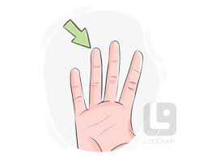
8
When you FINGERTIP LIKE:
a) you mistakenly like Facebook or Instagram posts
b) you do a very careful search of a place to try to find evidence relating to a crime
c) you blame someone for something that goes wrong

Slide 12
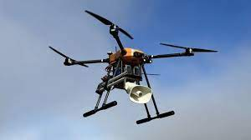
9
DRONEVERTISING is:
a) making a continuous low sound that can be compared
to the noise drones produce
b) making new products or offering new services using drones
c) using drones for advertising

Slide 13
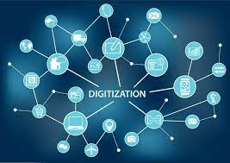
10
TO DIGITIZE means:
a) to store electronic information or documents
that you no longer need to use regularly
b) to put information into the form of a series of numbers 0 and 1,
usually so that it can be understood and used by a computer
c) to put information into a form in which it can be stored,
and which can only be read using special technology or knowledge

